Slide 1

Weather Forecasting System
By SWAYAMPRABHA BABU
SHIVAM KUMAR SAHOO
KHUSHI SAHOO
SONALI GHOSE

Slide 2
Content
Introduction
Importance of Weather
About my Project
Tools Used
Screenshot of code
Screenshot of output
Future Scope
Conclusion

Slide 3
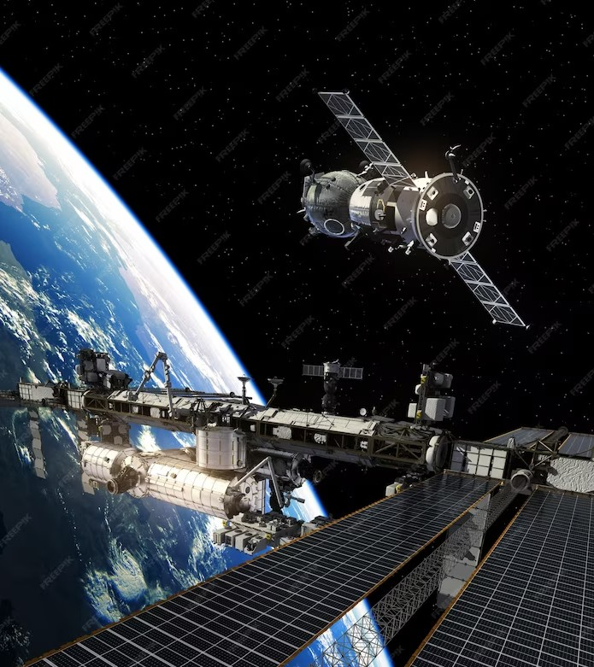
Introduction
Weather forecasting is the prediction of what the atmosphere will be like in a particular place by using technology and scientific knowledge to make weather observations.
Forecasting the weather involves recording the ongoing measurements of :
Temperature
Pressure
Humidity

Slide 4
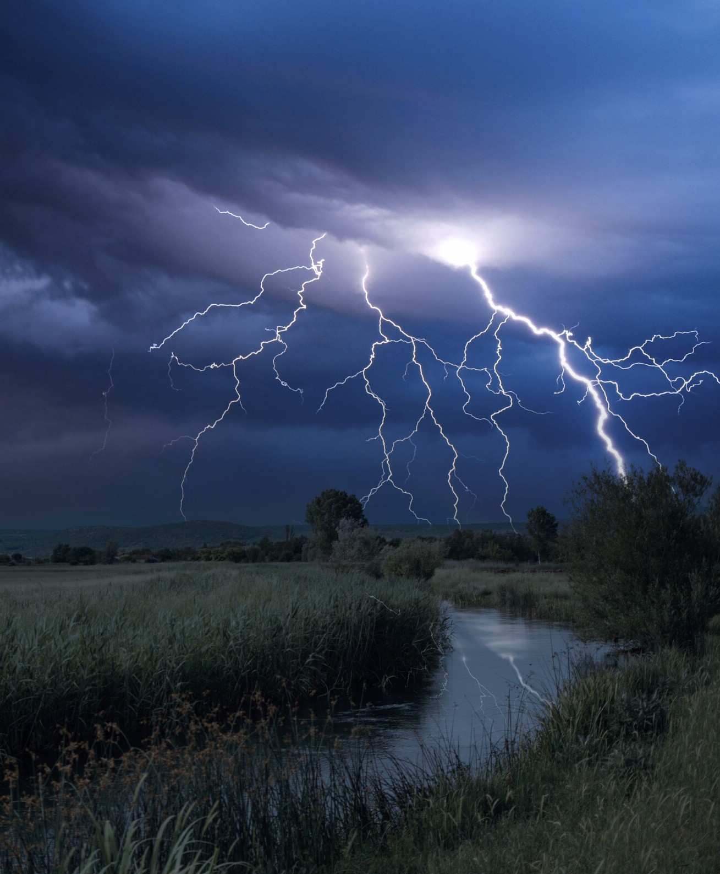
Importance of Weather
These weather forecast is important for :
Agriculture
Disaster Preparedness
Transportation
Ocean Navigation

Slide 5
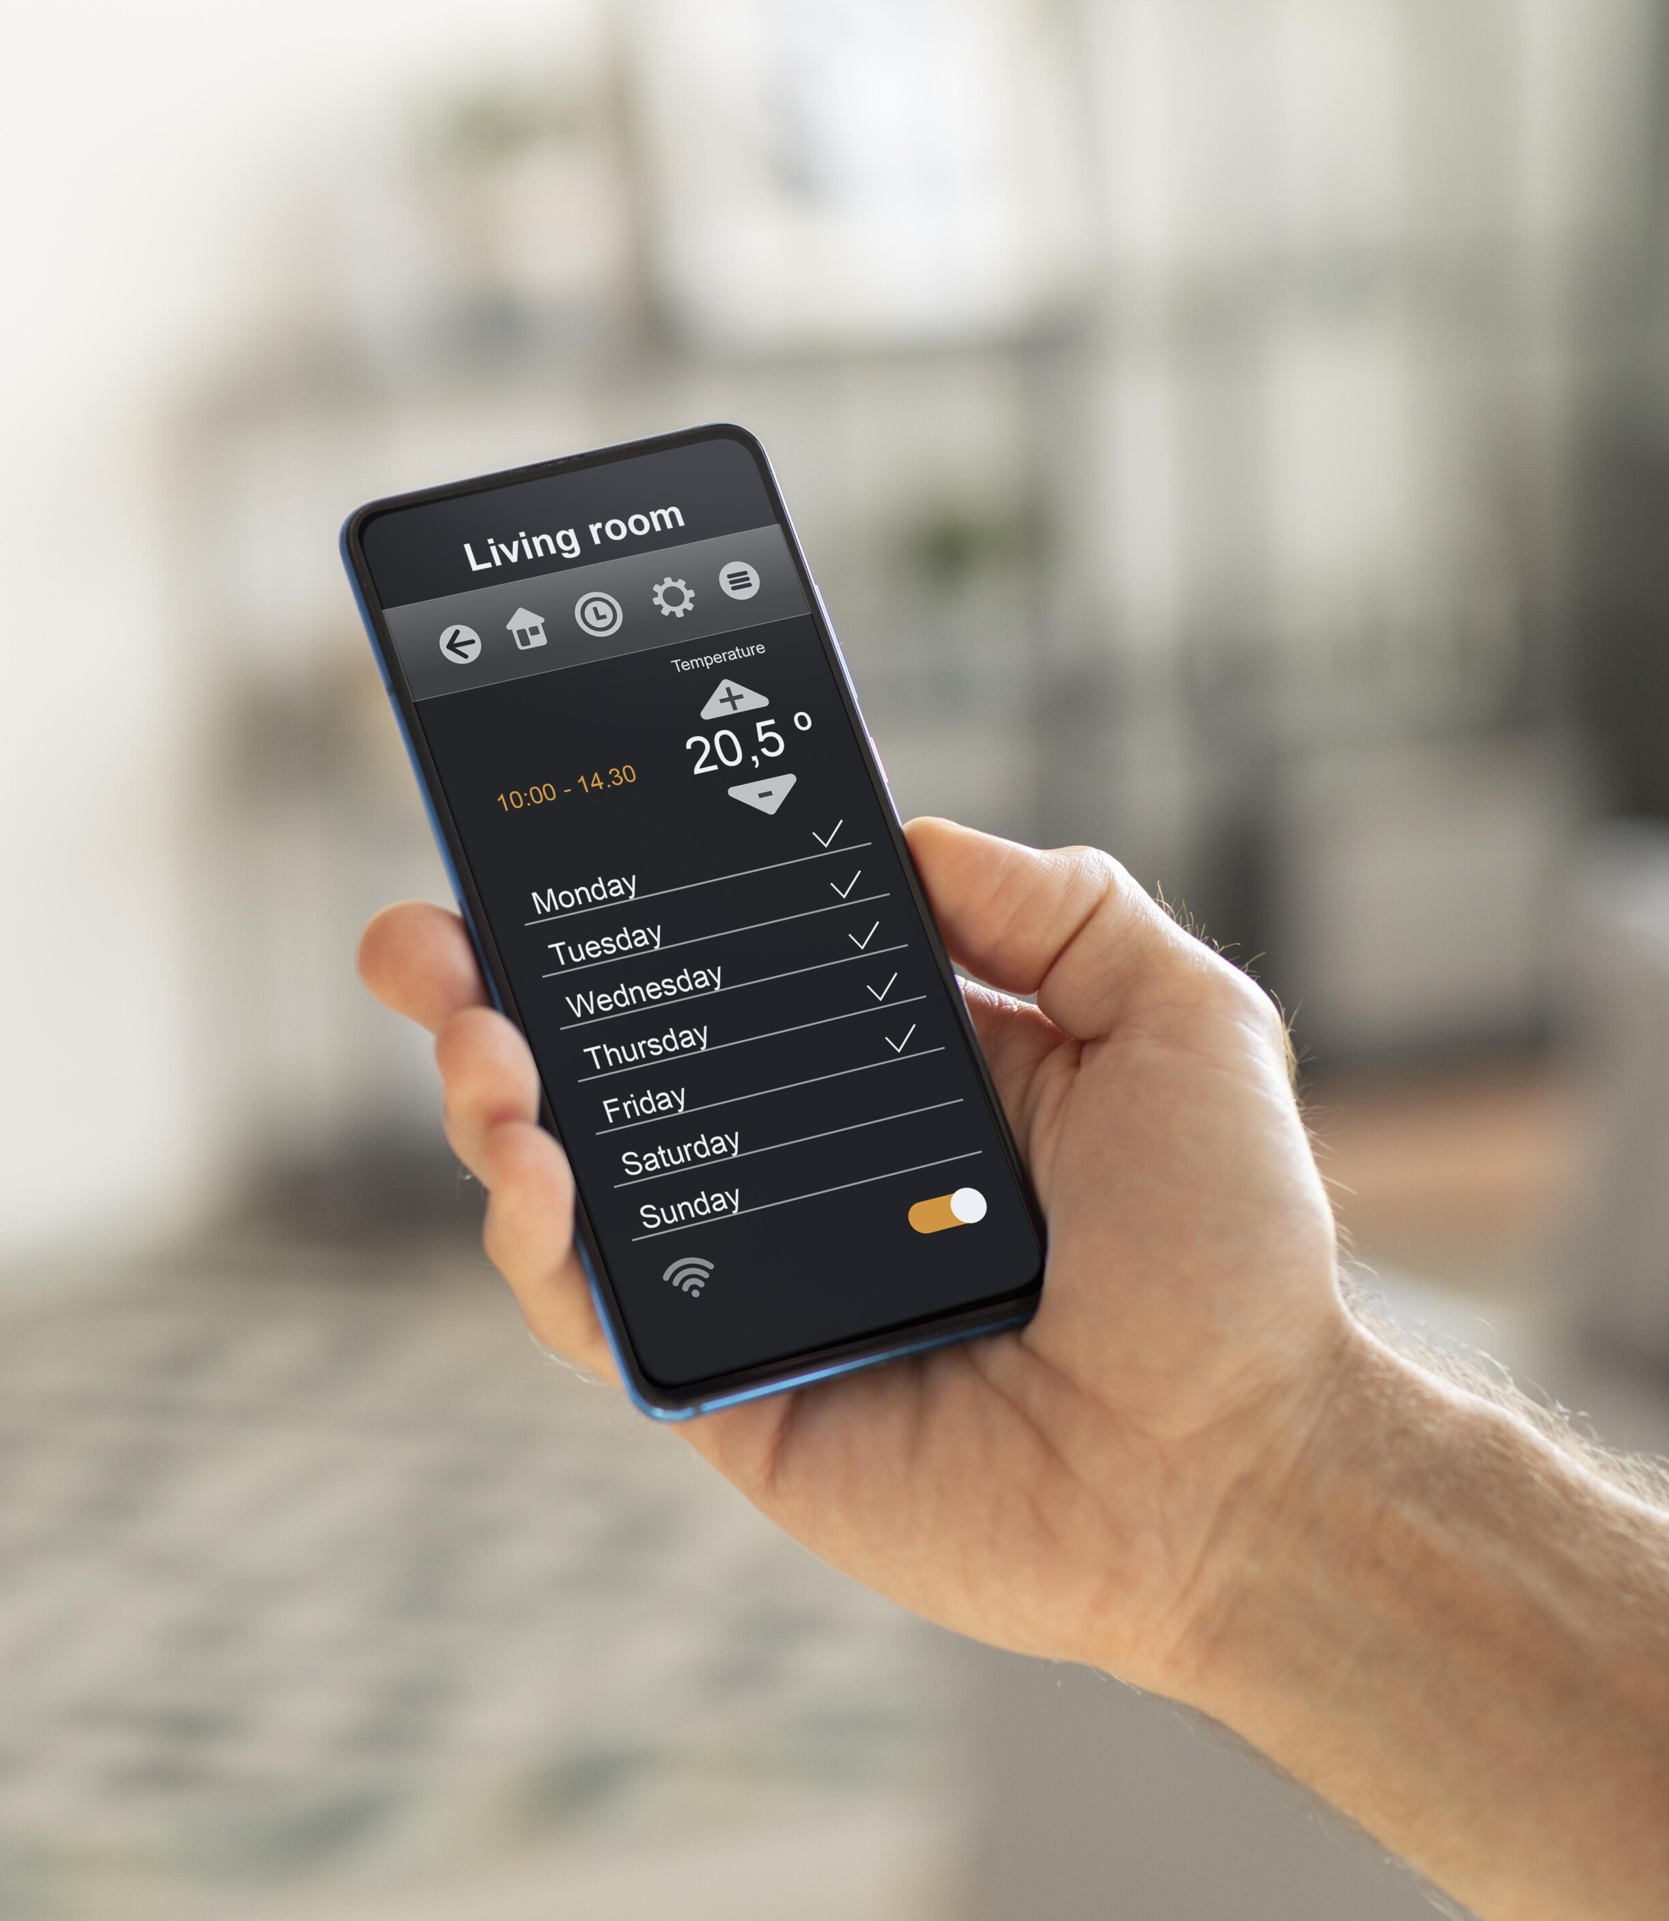
About My Project
Here, in my project I have made an web application to forecast the weather.
In this web app, you can get the essential insights of the current weather conditions.

Slide 6

Tools Used :
HTML
CSS
JavaScript
OpenWeatherMap API

Slide 7

1. HTML
The Hyper Text Markup Language or HTML is the standard markup language for documents designed to be displayed in a web browser.

Slide 8

2.CSS
Cascading Style Sheets (CSS) is a style sheet language is designed to enable the separation of content and presentation, including layout, colors, and fonts.

Slide 9

3.JavaScript
JavaScript (JS) is the most popular lightweight, interpreted compiled programming language. It can be used for both Client-side as well as Server-side developments.
JavaScript also known as a scripting language for web pages.

Slide 10

4.OpenWeatherMap API
OpenWeatherMap is an online service, owned by OpenWeather Ltd, that provides global weather data via API, including current weather data, forecasts, nowcasts and historical weather data for any geographical location.

Slide 11
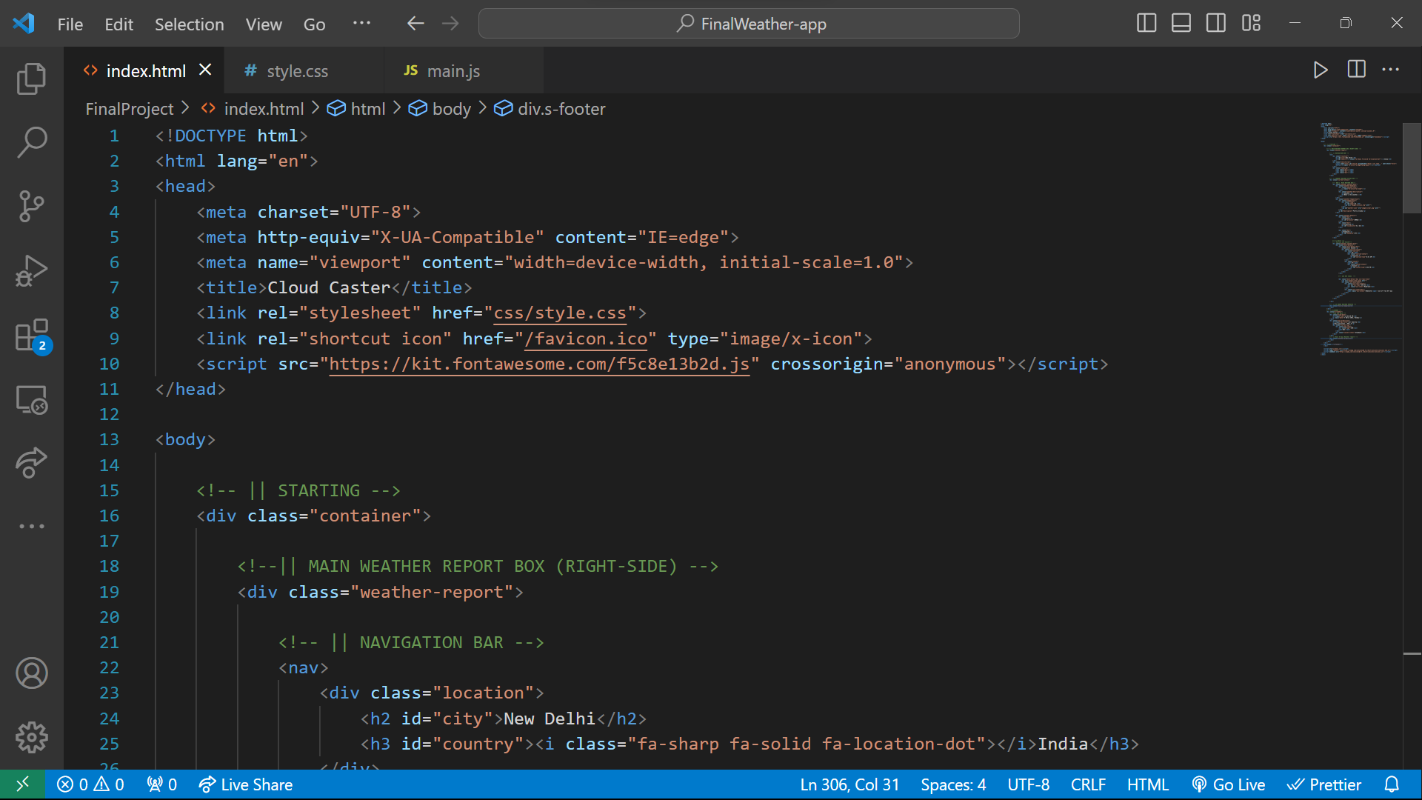
Code : HTML

Slide 12
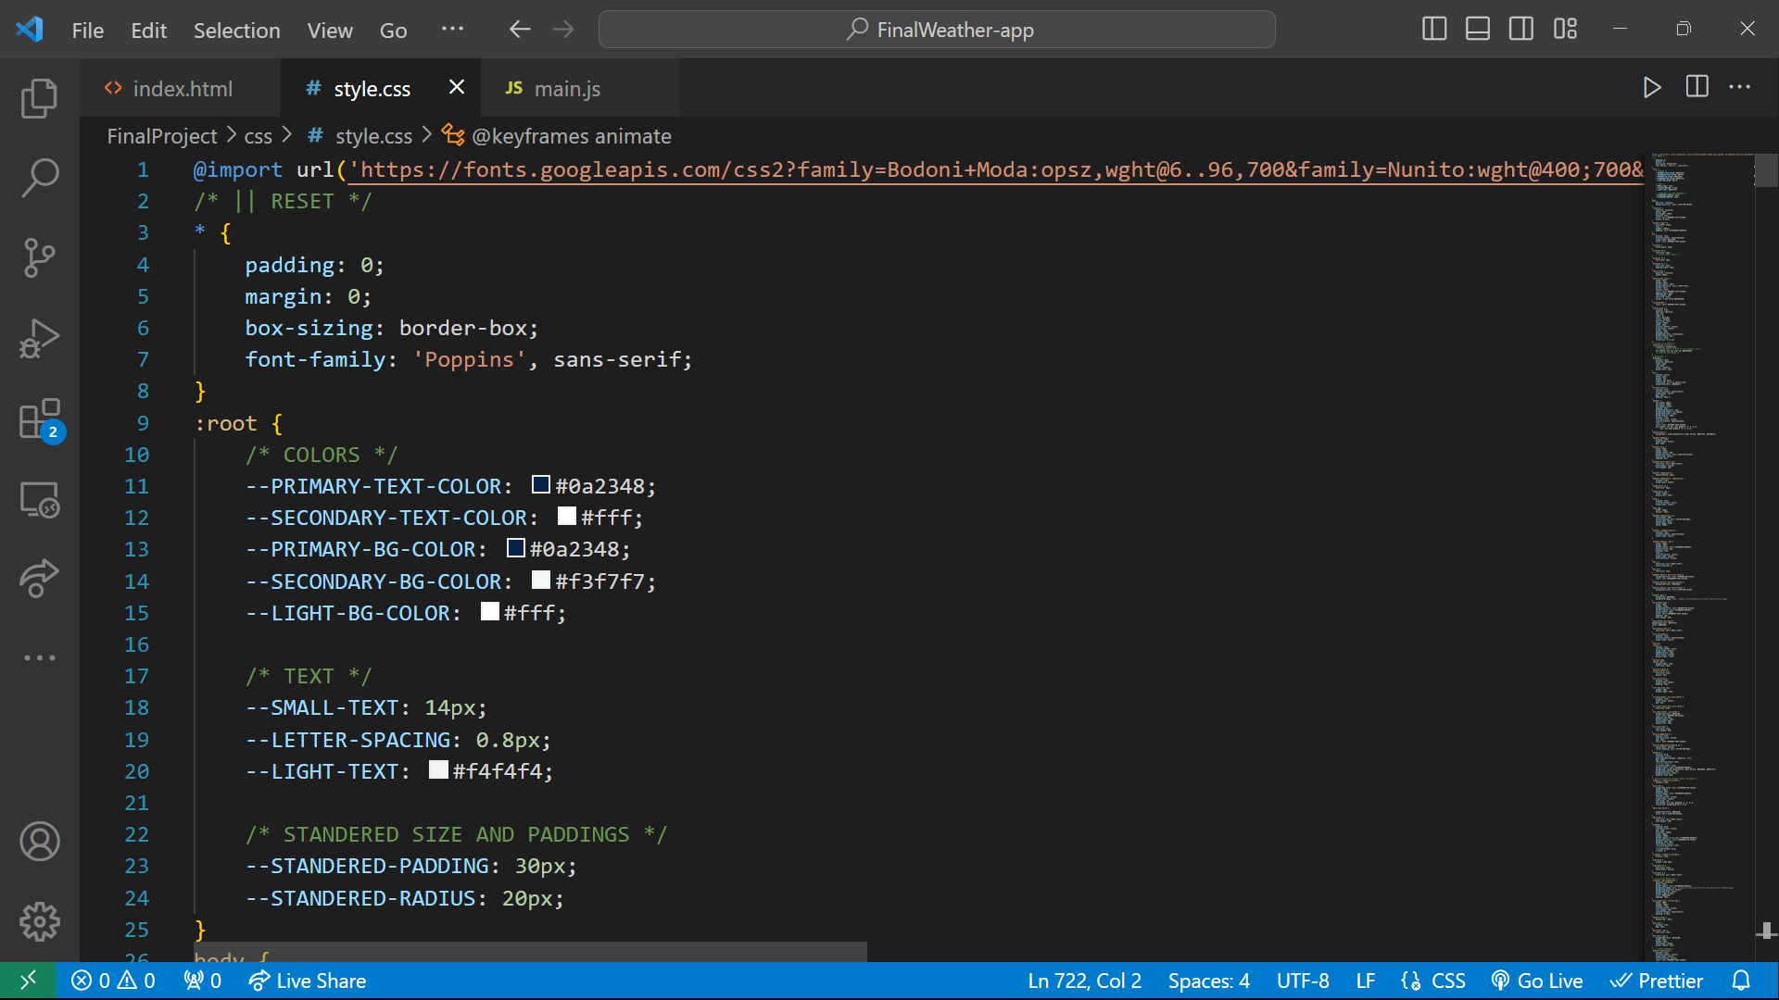
CSS

Slide 13
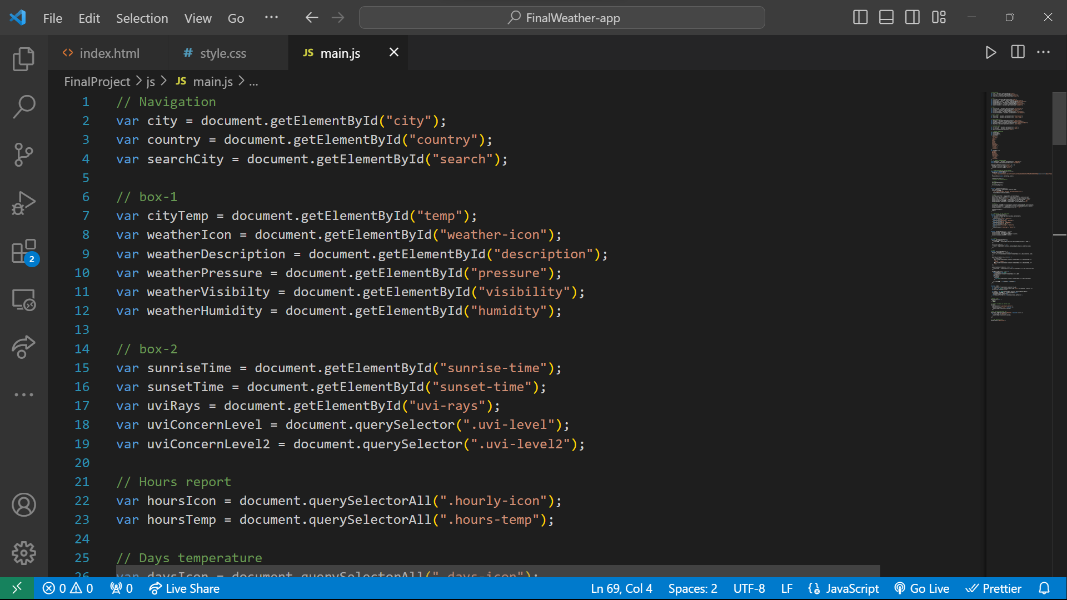
JavaScript

Slide 14
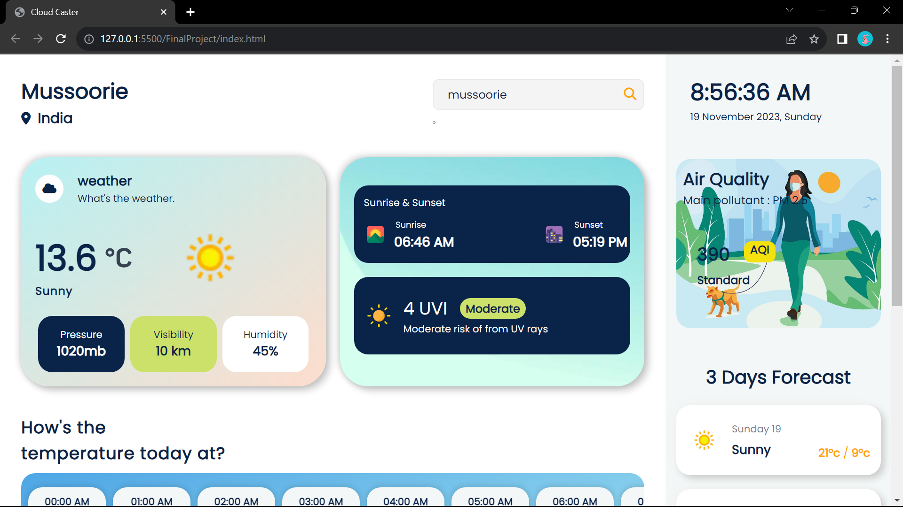
Output :

Slide 15
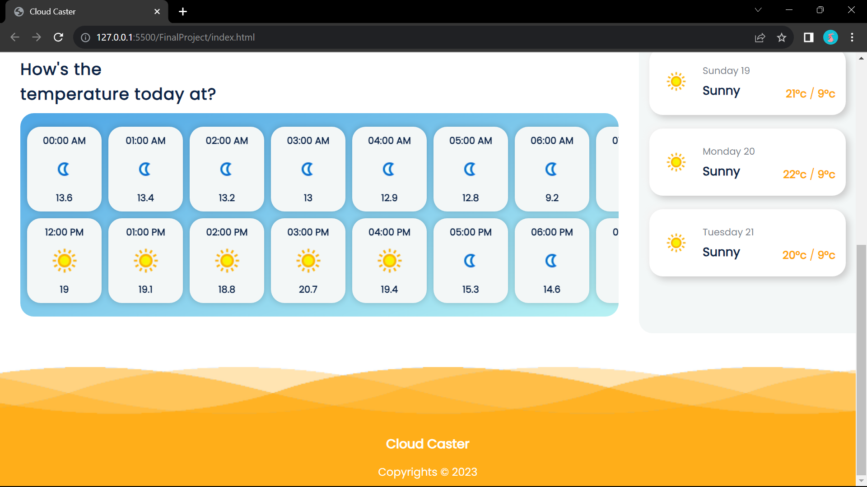

Slide 16
Future Scope
Addition of Technologies :
Artificial Intelligence
Internet of Things

Slide 17
Conclusion :
This weather forecasting project has provided valuable insights into the weather conditions and contribute to research and development, support agriculture and education and outsearch.

Slide 18
Thank You !

